Slide 1
Shared Island, Shared Opportunity:
Climate and Biodiversity Research
Dr Helen Johnston & Dr Jeanne Moore
National Economic and Social Council
North South Ministerial Council, Environmental Sector, Armagh, 10th June, 2024

Slide 2
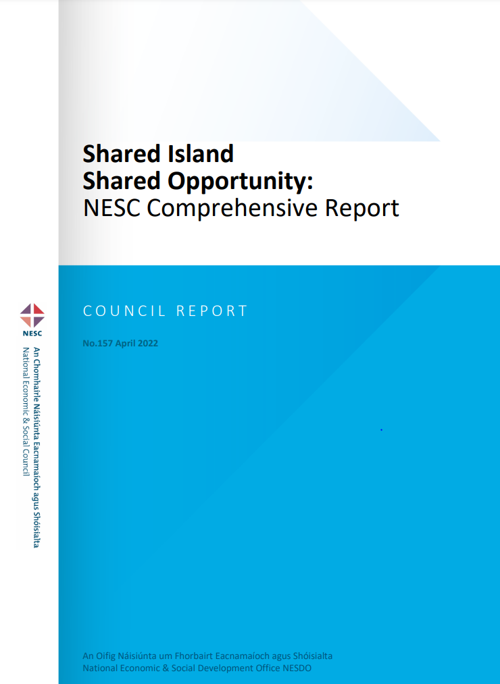
NESC Shared Island Project
Comprehensive Report
Climate & Biodiversity
8 Other Reports
Scoping Paper
Good Jobs
The Island Economy
Regional Perspective
Combating Poverty
Mental Health
Social Enterprise
North-West Focus Group Report
www.nesc.ie

Slide 3
NESC Three Overarching Conclusions
There is very significant support, in practice, for an all-island approach to key economic, social, environmental, and well-being challenges
Climate change and biodiversity loss provide a clear and urgent platform for ambitious all-island action and collaboration
Key factors which are shaping current and future collaboration are:
A shared agenda
Resources
Political certainty and support
Legislative and regulatory coherence
Collaborative projects

Slide 4
Shared Island – Climate Change & Biodiversity Loss
Indifference to geographical boundaries
Increasing urgency to address these issues in an integrated way
Both Ireland and Northern Ireland face similar challenges in relation to environmental protection, climate mitigation and protection of biodiversity

Slide 5
Three Key Themes

Slide 6
Shared ambition: A shared and inspiring vision and statement of common purpose
For integrated climate and biodiversity action across the island to be developed through a joint statement of common purpose
Outline the shared climate and biodiversity challenges and ambition, with a commitment to work collaboratively across sectors and communities
A potential role for the institutions and bodies established under the Good Friday Agreement
Explore how to engage young people on an all-island basis & develop creative approaches

Slide 7
Shared experience: Support existing collaborations
Use collaborative ways of working on environmental challenges to mitigate against climate change and protect nature
Create a distinct funding stream for exploring the work of existing environmental networks in Ireland and Northern Ireland
Series of all-island conferences on key themes

Slide 8
Five Areas of Shared Opportunity
Strategic working groups could provide a focus for collaborative, forward-looking discussion and formulation of advice on shared opportunities in key areas
These could include:
Sustainable Agriculture
Circular Economy and Bio-economy
Renewable Energy
Networks for Nature
Marine and Coastal Impacts of Climate Change

Slide 9
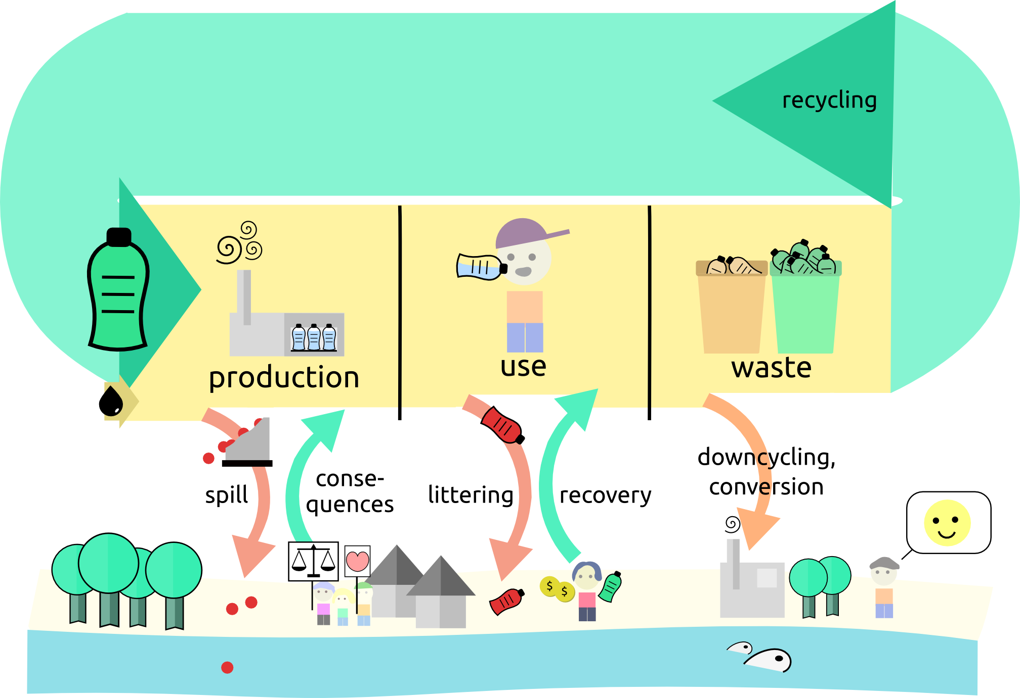
All-Island Opportunities from a Circular Economy and Bio-economy
Potential economies of scale and the resulting opportunity to gain competitive advantage and maximise benefits
Both jurisdictions are developing circular economy strategies
Initiatives already underway

Slide 10
Valuing Networks for Nature
To build on the progress of the All-Ireland Pollinator Plan - explore nature recovery networks and a ‘wildlife web’
Marine nature-based solutions-mapping of blue carbon and natural carbon storage.
Potential of natural capital across the island
Management of invasive alien species

Slide 11
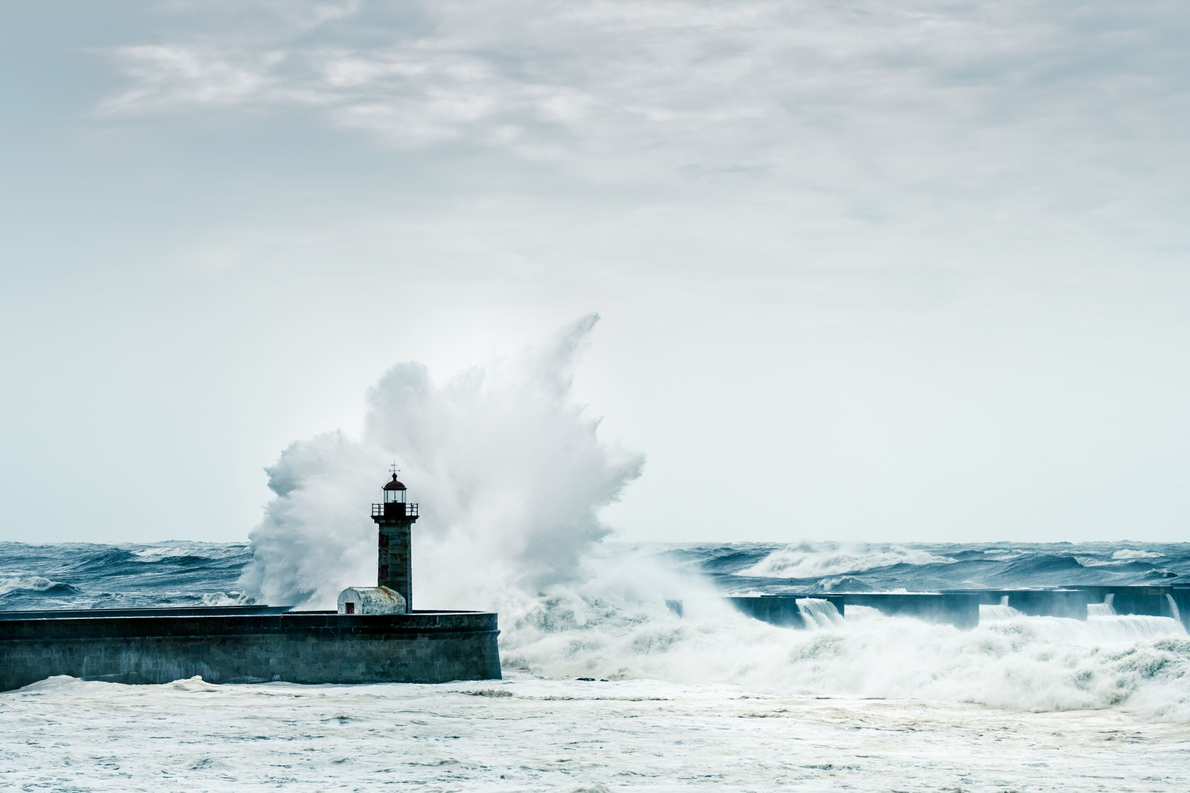
Marine and Coastal Impacts of Climate Change
Flood water management, coastal erosion and the impacts of a rise in sea-levels
An all-island review of risks, assets and infrastructure
Significant gap in information on changing ocean and climate
The development of all-island climate services; safe and sustainable food from the ocean; healthy marine environment and ecosystems; and building a sustainable blue economy

Slide 12
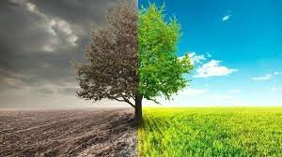
Future Focus ….
The appetite for collaboration has continued to build since NESC work, e.g.
Research - All Island Climate and Biodiversity Research Network, Shared Island, PEACEPLUS
Civil society - Northern Ireland Environment Link (NIEL) and Irish Environmental Network (IEN) collaborations
Business - Ibec and CBI Shared Energy Futures report called for an "all-island" approach to energy security and climate challenges
Cross-border Bodies: Loughs Agency leading EU marine tracking project.

Slide 13
NESC ….
NESC has deepened its focus on climate and biodiversity
Just Transition in Agriculture and Land Use report & event
Natural Capital Accounting report & event
NESC continues to bring a shared island focus to its work
Energy research programme

Slide 14
Thank you
www.nesc.ie
helen.johnston@nesc.ie

